Slide 1
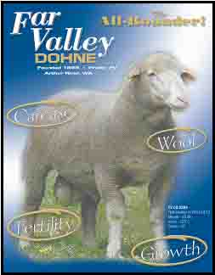

Far
Valley
DOHNE
Notes:
Six Month Old Dohne Rams

Slide 2
The Physical Environment:
Greater part of sheep production areas in South Africa comprise:
- Arid pastoral conditions in central areas,
subject to periodic drought
- and, in eastern summer
rainfall areas, course
native grassland - “Sourveld”
of low nutritional value
Hardier, better adapted
Sheep types required
Breeding objectives must be in
Harmony with the Physical Environment

Slide 3
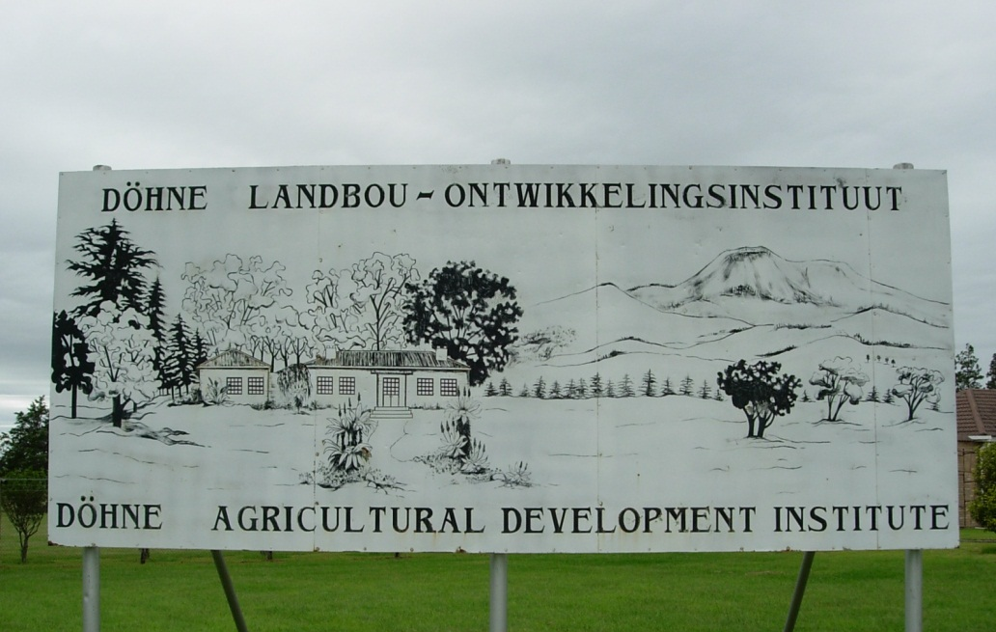
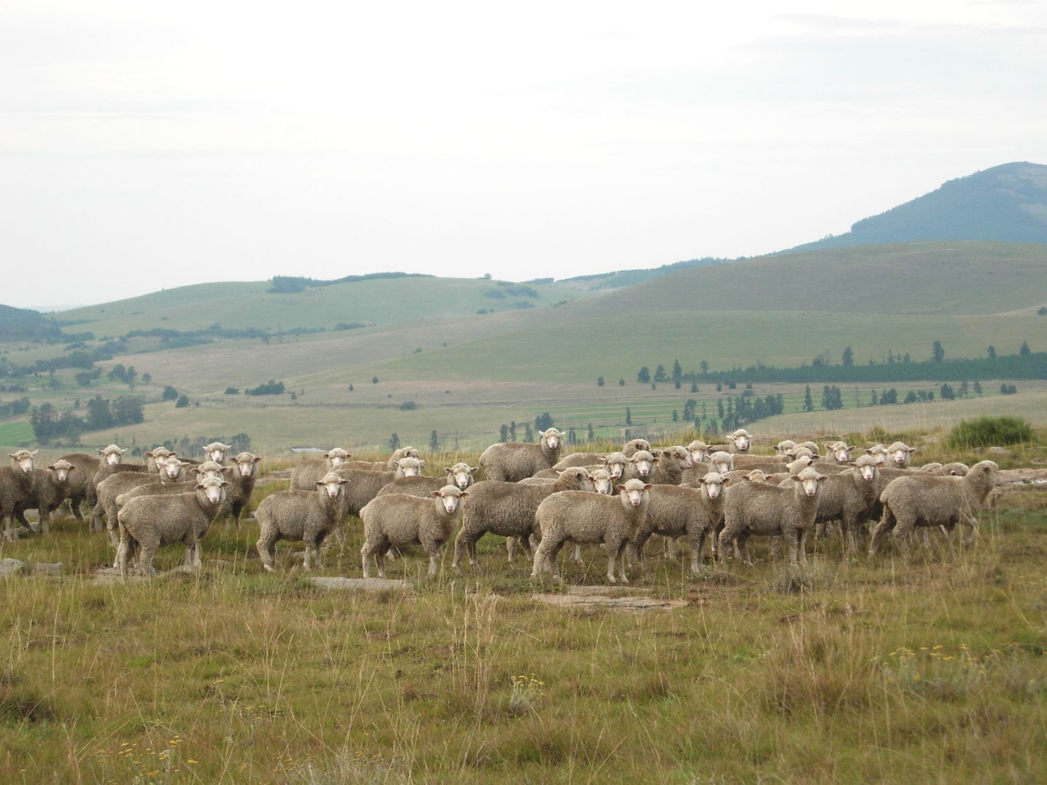
Dohne breeding programme initiated at the Dohne Ag. Research Institute in 1939
Lambs on Dohne “Sourveld”
Dohne Peak in the distance right

Slide 4
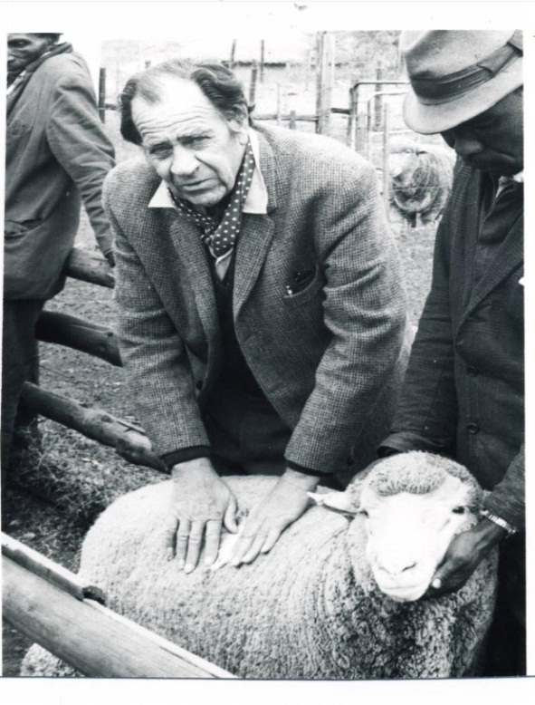
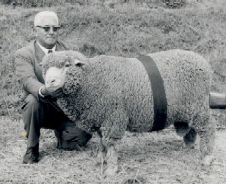
HISTORY
OBJECTIVE: To breed a dual-purpose, fine-woolled
Merino-type, better adapted to marginal environments.
BREEDING PROGRAMME: Commenced in 1939 at Dohne
Agricultural Research Institute, Stutterheim.
German Mutton Merino rams X Merino ewes
Subsequent generations interbred and selected
for desired type.
Initiator: JJJ Kotzé
FIRST PRIVATE STUD – 1942
Gerald Featherstone
Waterford Farm
Stutterheim

Slide 5
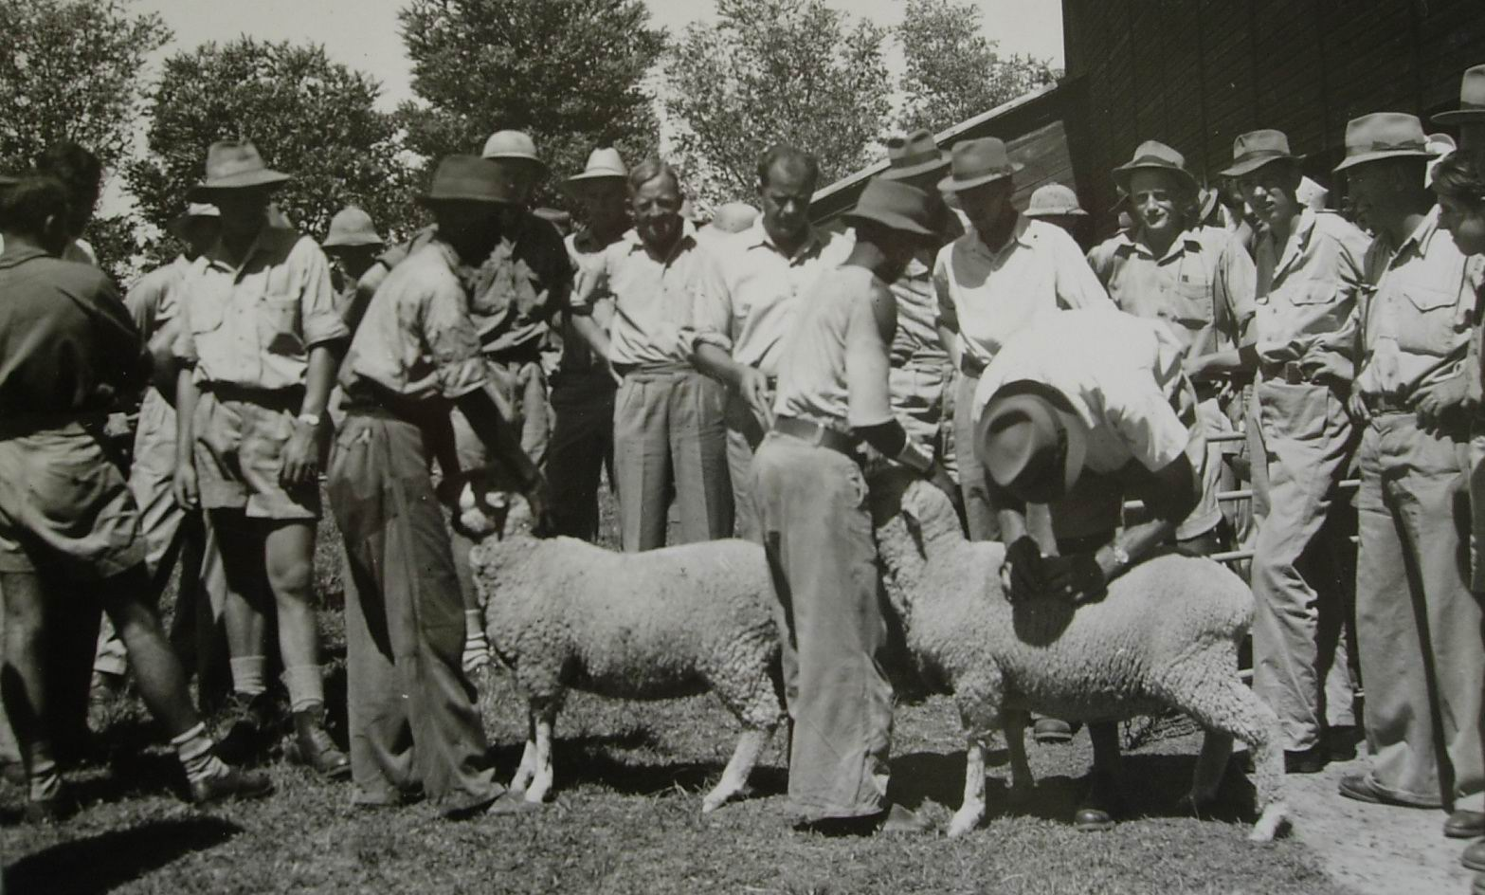

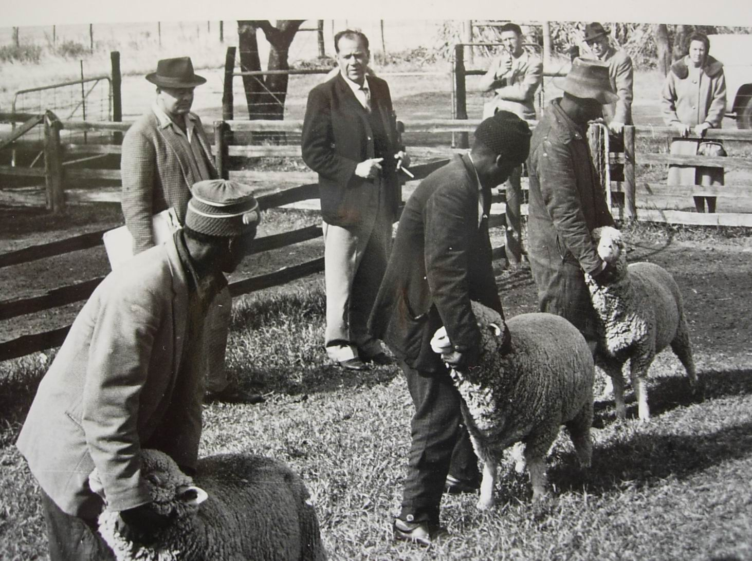
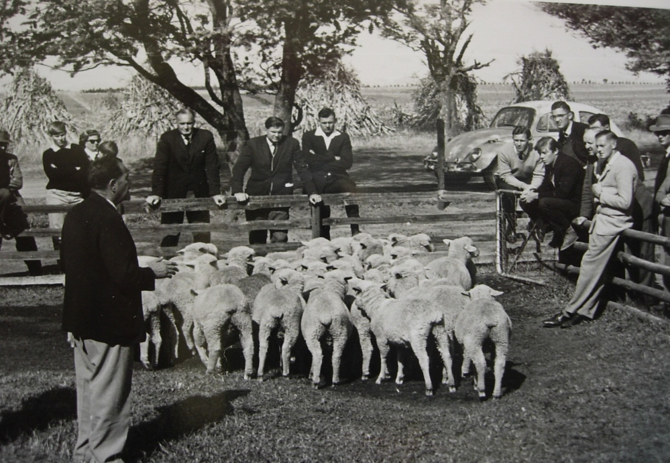
1949
First Logo
Mr Kotzé demonstrating at the inaugural meeting of the Society in May 1966

Slide 6
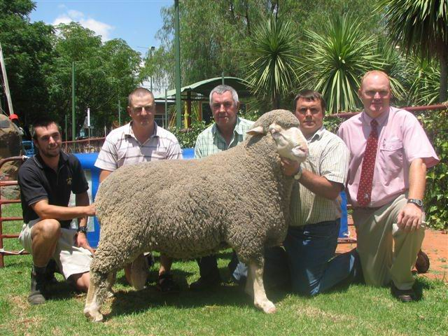
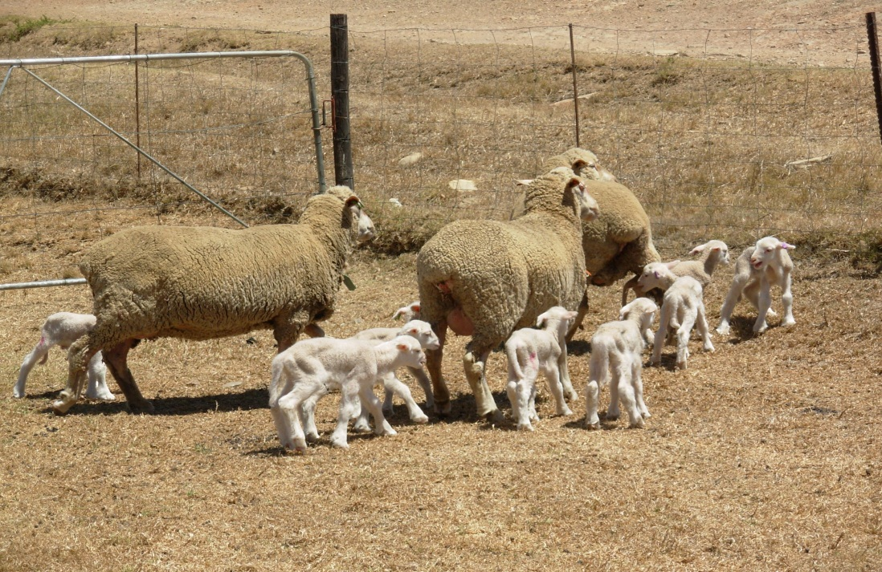

The Dohne in South Africa Today
112 Registered Dohne Studs
34,000 Registered animals
2,400 rams sold at public auction
33% of the total ram market for woolled sheep
Top price ram R115,000 ($16,000)
National Sale Bloemfontein 2008
Sold by WESKA Stud, Bredasdorp

Slide 7
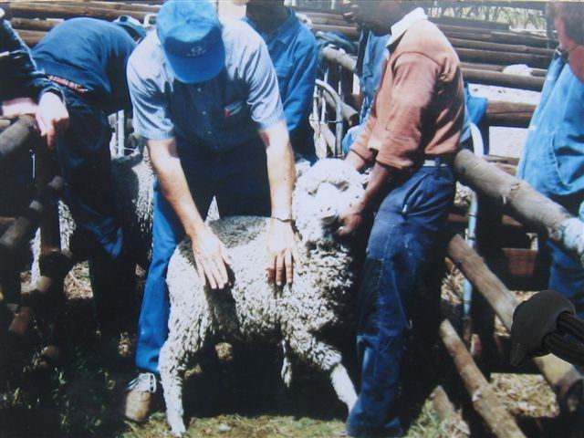
The Dohne in Australia
1997 - negotiations between Alex Leach & Geoff Beeck from Western Australia and the Dohne Merino Society of South Africa 600 embryos.

Slide 8
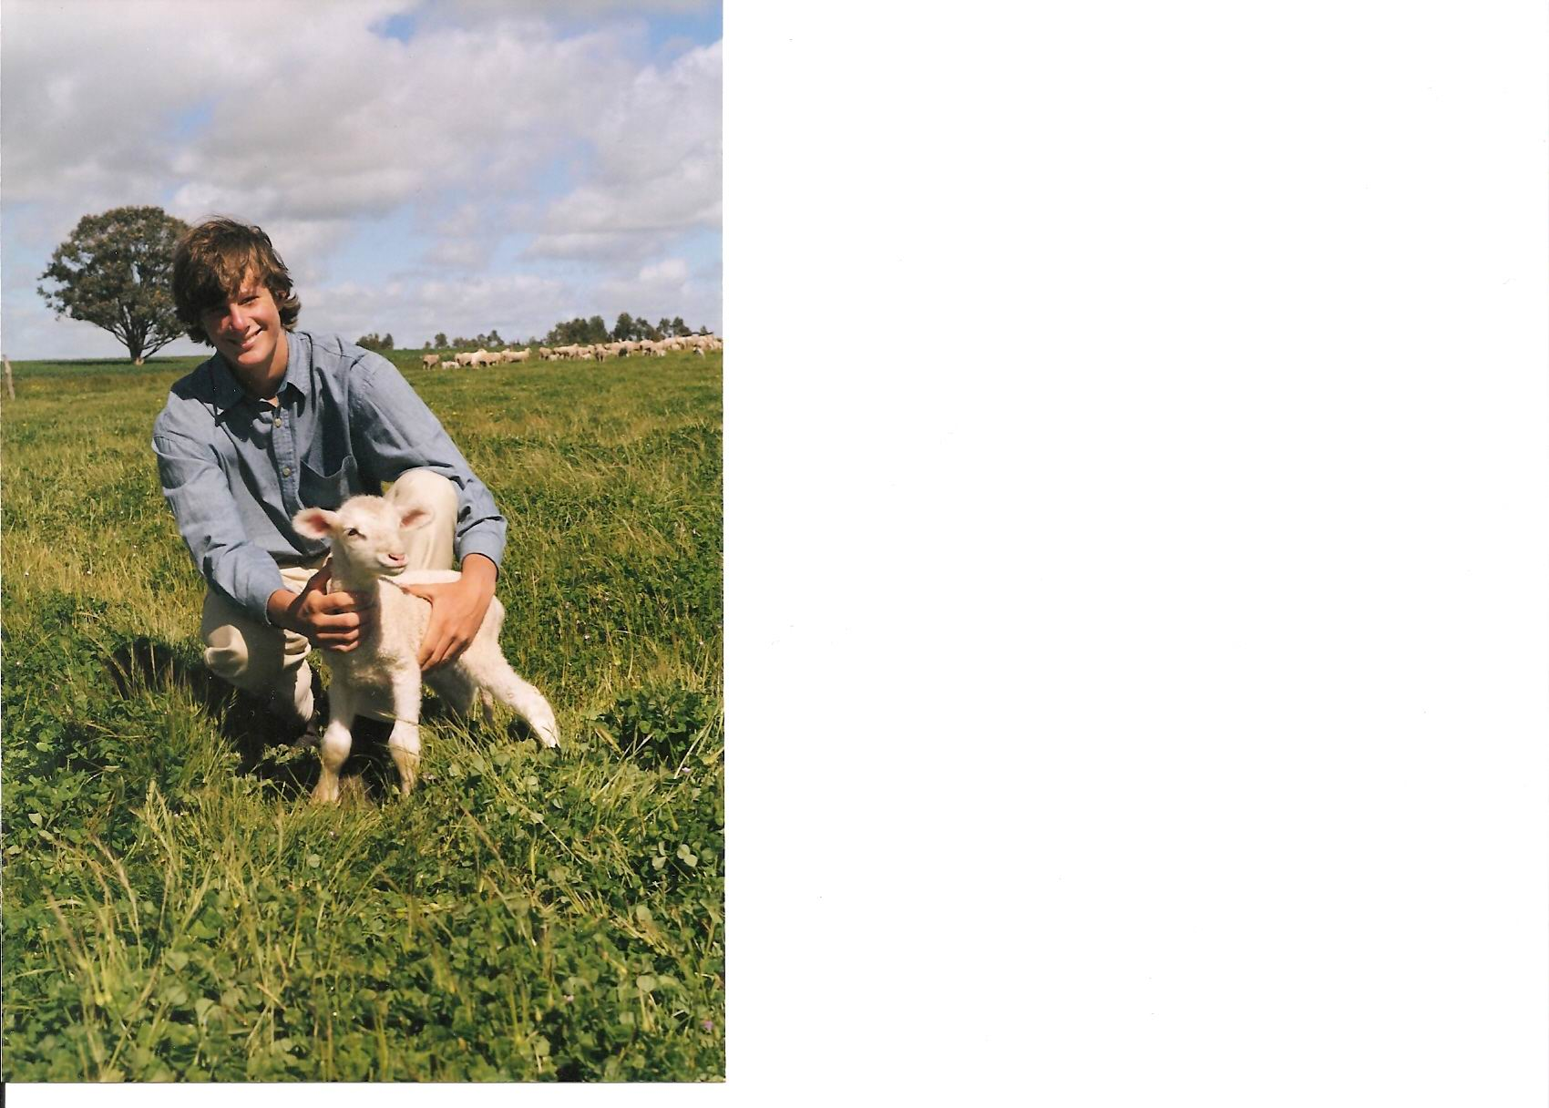
The first Australian born Pure Bred Dohne Summerfield WA October 1998
Australia’s First Council was formed in 2000

Slide 9
Quality Assessment
Full Pedigree information
Every animal visually assessed
All animals performance recorded
All Dohnes have EBV’s calculated from their pedigree and performance information.
Grade | Index Value | Visual Assessment
AA | 105 & Greater | Above Average
A | 90 to 105 | Average
B | 80 to 90 | Below Average
C | Less than 80 | Cull

Slide 10
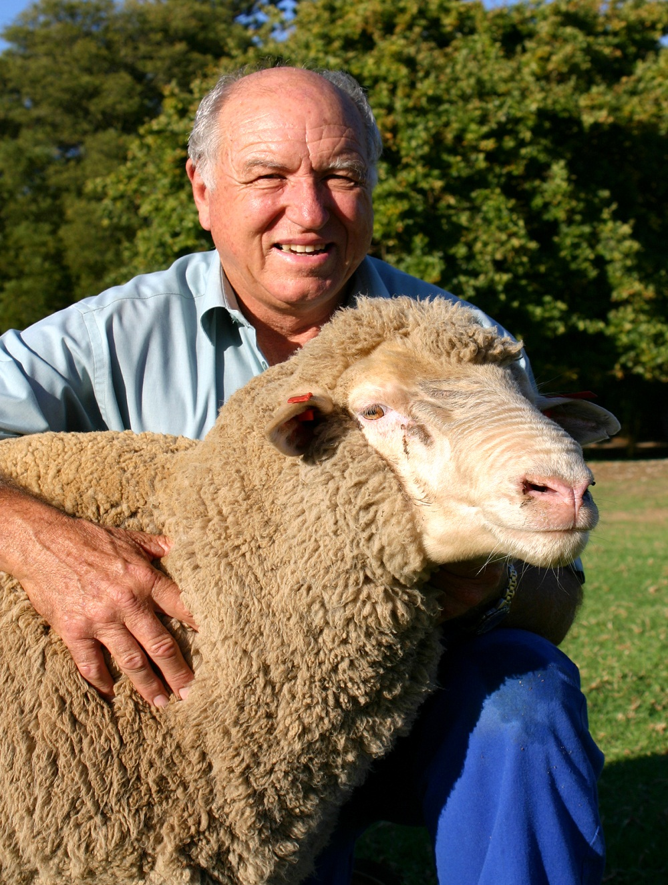
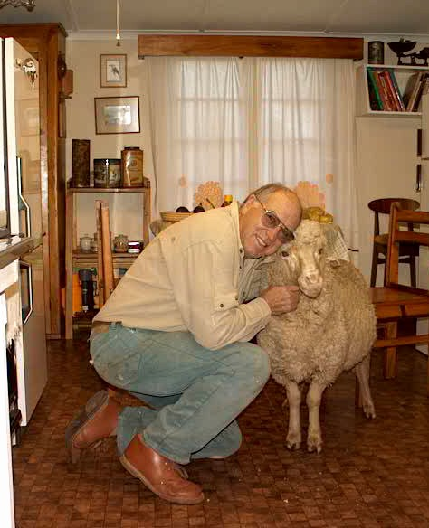
The Role of Cameron McMaster

Slide 11
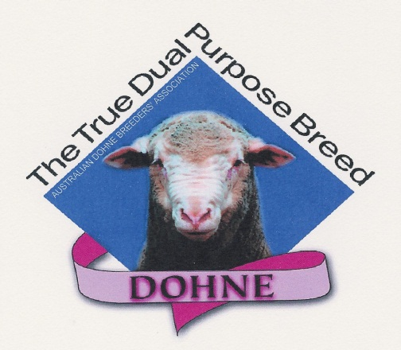

Slide 12

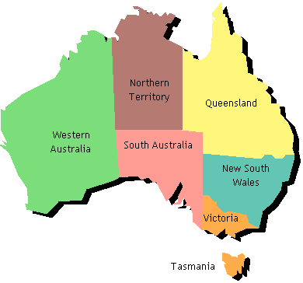
The Dohne In Australia Today 197 Studs 14734 Registered Animals
Qld
7 Breeders
NSW
60 Breeders
Vic
16 Breeders
Tas
1 Breeder
WA
28 Breeders
SA
16 Breeders

Slide 13
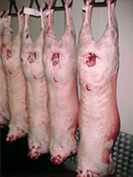
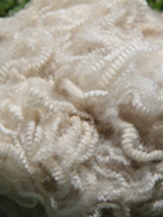
The Dohne Tomorrow?
Wool
Worldwide need for protein
Mulesing
“Greener world”
Ease of Management
Pressure from cropping
Make money

Slide 14
Number of Dohne stud sheep bred

Slide 15
Dohne genetic improvement
20% genetic improvement in 10 years
Continuous high rates of improvement!

Slide 16
Body Weight - actual & predicted
Continuous high rates of improvement!
7% gain + 5.5 predicted

Slide 17
Fleece Weight - actual & predicted
Maintain performance
0.5% reduction + -1% predicted

Slide 18
Fibre Diameter - actual & predicted
Continuous high rates of improvement!
7um reduction + -6um predicted

Slide 19
FD CV - actual
Continuous high rates of improvement!
7% reduction

Slide 20
Muscle Depth - actual & predicted
5mm gain + 2mm predicted
Continuous high rates of improvement!

Slide 21
Fat depth - actual & predicted
Maintain performance
0.5mm reduction + maintain predicted

Slide 22
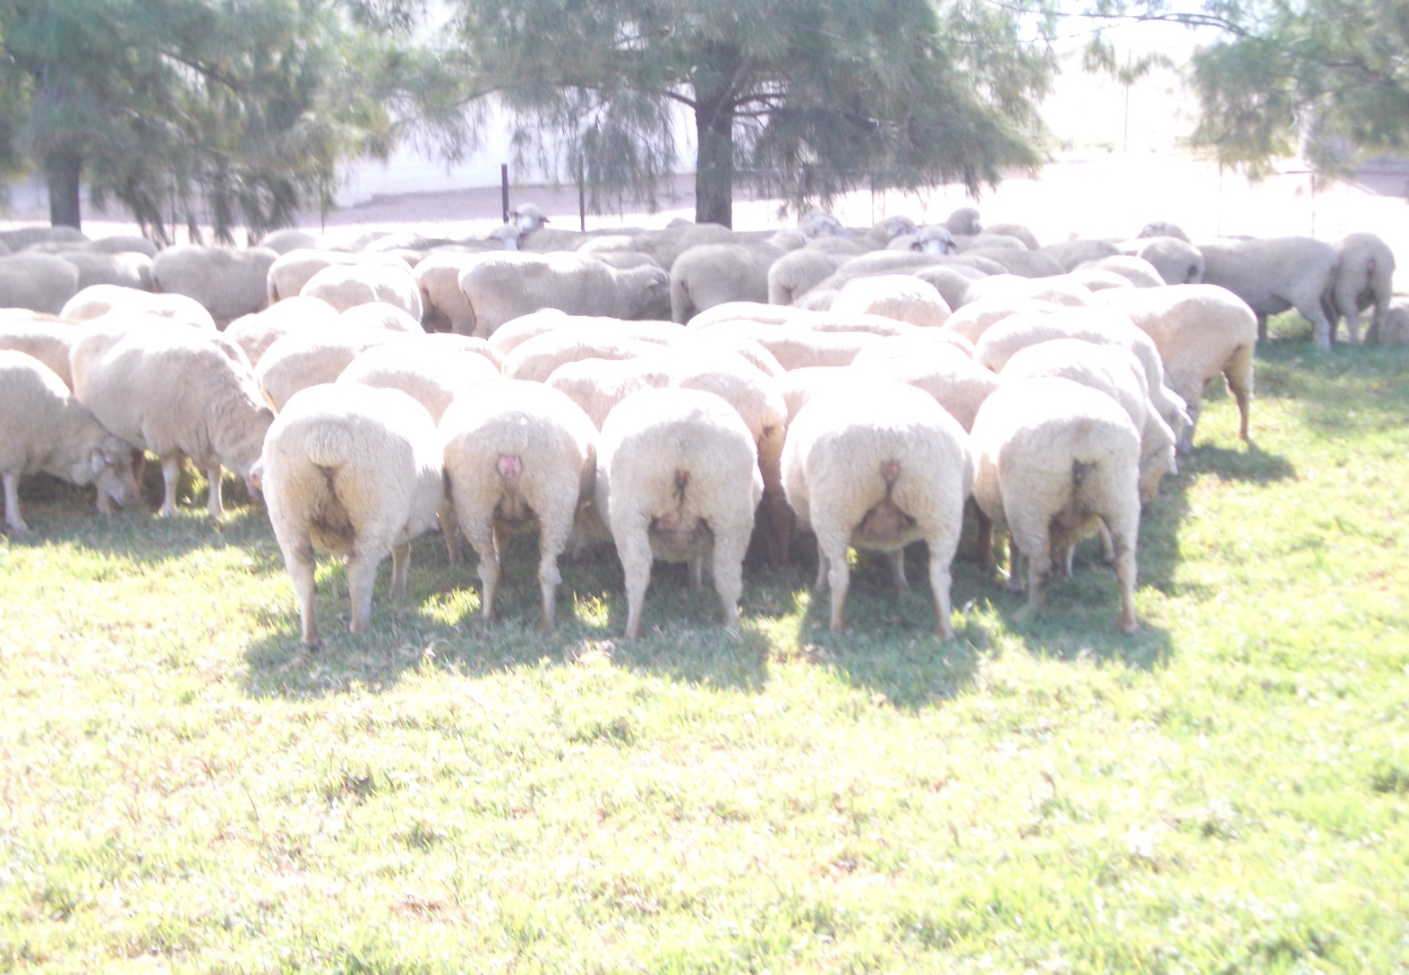

Slide 23
 |  |  | TABLE 1: APRIL 2010 SHEEP ENTERPRISE GROSS MARGIN ASSUMPTIONS
 |  |  | Merino |  | Term/Merino |  | BL/Merino |  | 2nd X |  | Dohne Basic |  | Dorper Basic |  | Dorper Plus F4 |  | Dohne Plus F4
 | Micron |  | 20 |  | 20 |  | 20 |  | 28 |  | 20 |  |  |  |  |  | 20
 | Cut/ kg. |  | 5.7 |  | 5.7 |  | 5.7 |  | 4.5 |  | 5 |  |  |  |  |  | 5
 | Yield |  | 70 |  | 70 |  | 70 |  | 65 |  | 65 |  |  |  |  |  | 65
 | Wool (Clean) |  | 920 |  | 920 |  | 920 |  | 450 |  | 920 |  |  |  |  |  | 920
 | Ewes Weight |  | 50 |  | 50 |  | 50 |  | 65 |  | 62 |  | 65 |  | 65 |  | 65
 | DSE |  | 2.1 |  | 2.3 |  | 2.3 |  | 2.6 |  | 2.5 |  | 2.3 |  | 2.3 |  | 2.5
 | Lambs/Wean (%) |  | 85 |  | 85 |  | 85 |  | 120 |  | 120 |  | 120 |  | 150 |  | 150
 | Lambs Value ($) |  | 90 |  | 110 |  | 110 |  | 120 |  | 110 |  | 100 |  | 100 |  | 110
 | GM/Ewes ($) |  | 80.57 |  | 94.31 |  | 98.86 |  | 96.81 |  | 102.3 |  | 94.5 |  | 121.13 |  | 139.9
 | GM/DSE ($) |  | 38.37 |  | 41 |  | 42.98 |  | 37.66 |  | 43.15 |  | 41.09 |  | 46.59 |  | 55.96
 | Wool vs Meat |  | 34/66 |  | 28/72 |  | 27/73 |  | 10/90 |  | 28/72 |  | 0/100 |  | 0/100 |  | 21/79

Slide 24
1960 1970 1980 1990 2000 2010
Meat : Wool price ratio
1960 1 : 3.2 2000 1 : 1.3
2010 1 : 1

Slide 27
Averaged 128% from ewes mated at Mulesing time in 2010.
An increase of 53% in 12 years.
We cut 45 kg/ha of 18.5 micron wool.
An increase of 9 kgs in 12 years.
We are now running 12.4 winter d.s.e.’s/ha
Up 3.5 in 12 years

Slide 28
Current Status at Far Valley
Slight increase in wool production, whilst reducing micron.
Putting more meat on faster growing lambs.
Rapidly increasing lambing percentages.
Introducing a lot hardier and easy care genotype into our flock.

Slide 29
Proportion of Income from Sheep
Twelve years ago we were roughly 70% income from Wool and 30% from Meat.
Now 60% Meat and 40% Wool
Not far from main objective,
70% meat and 30% wool

Slide 30
HOW DID THIS COME ABOUT?
Not necessarily from less wool cut per hectare.
Increase in sheep sales.
Increase in carrying capacity (better feed converters).
In 2 words… “more production.”

Slide 31
Marketing Percentages
More important than lambing or weaning percentages.
That is the number of lambs sold per ewe per year.

Slide 32
The Dohne Advantage
Because you have the ability to sell your lambs faster, it also has a carryover effect on the number of ewes you can retain for breeding.

Slide 33
Dohne Selection Objectives
The fundamental Objective is financial
- to realise the highest possible profit.
Flocks achieving the highest gross margins exhibit the following features;
70% of total income is derived from meat production and 30% from wool.
Ewes in full production comprise at least 60% of the total flock.
High reproductive rates are being achieved.

Slide 34
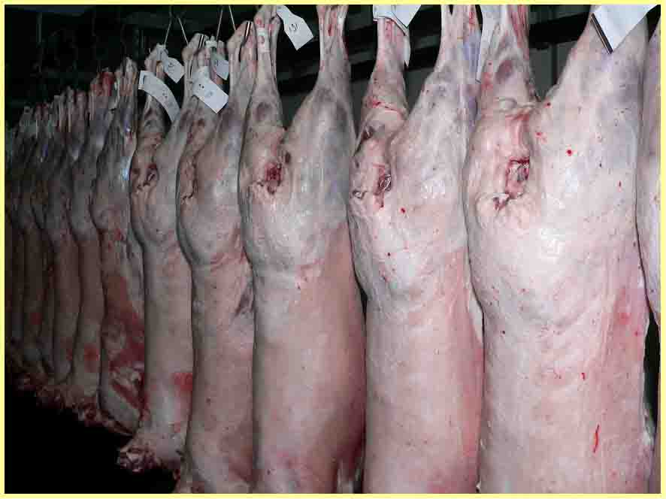

Slide 35
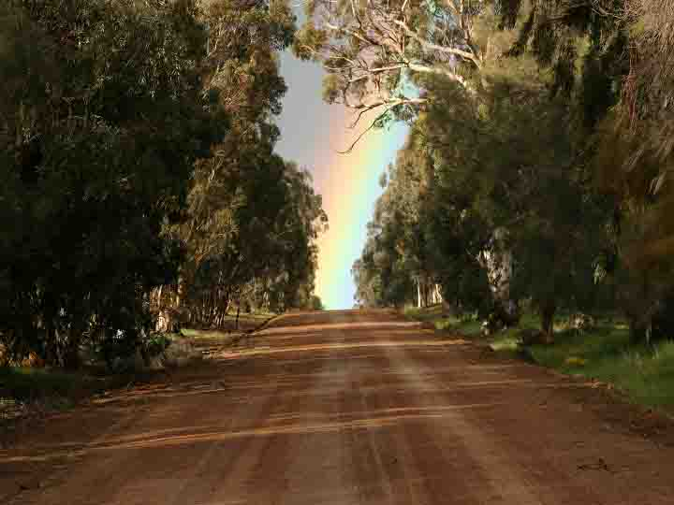
The End

Slide 37
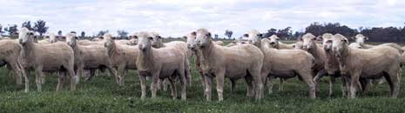

Slide 38
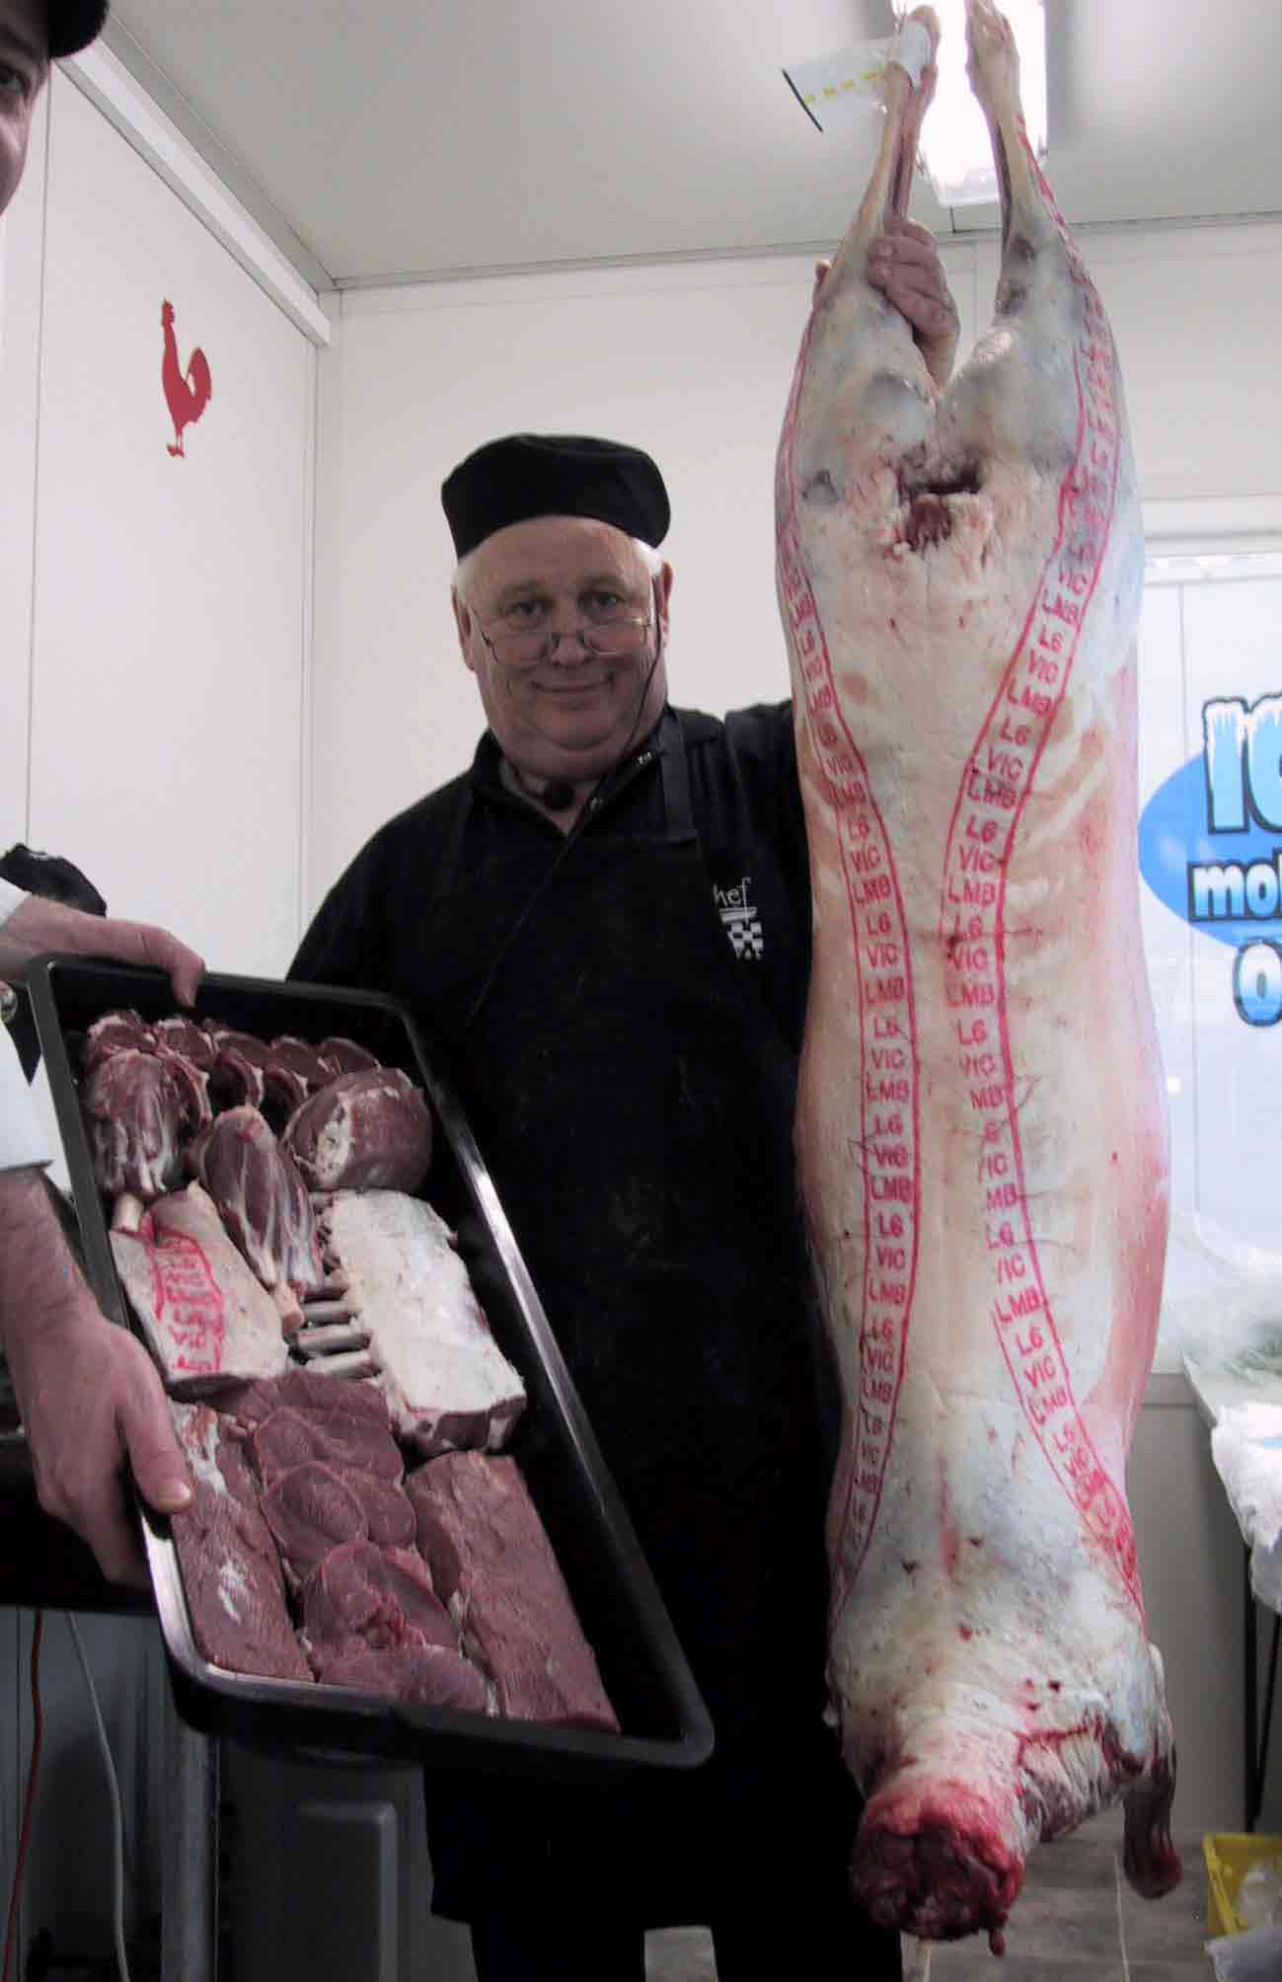

Slide 41
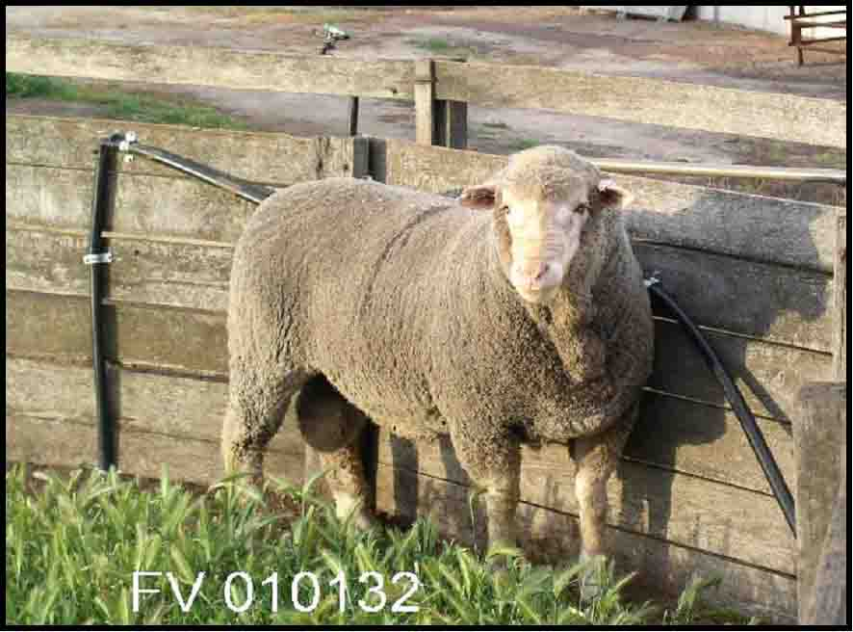
Notes:
FV 0132 he is one of Aust. Leading sires

Slide 42
Why Dohnes?
In the sheep industry, the Dohne is not recognized as being the best in any one particular area or trait.
They certainly are not the biggest.

Slide 46
A Merino can cut more wool per head
A Texel might have a better carcass.
A pure White Suffolk might grow faster.
A Finn might have more lambs.
A Damara might be hardier or tougher.

Slide 47
But the Dohne is very good at all the above.
It is a very uncomplicated sheep and as you learn more about the breed, you will understand better, how and why it can do what it does.
It is the best multi purpose woolled sheep in the world today.

Slide 48
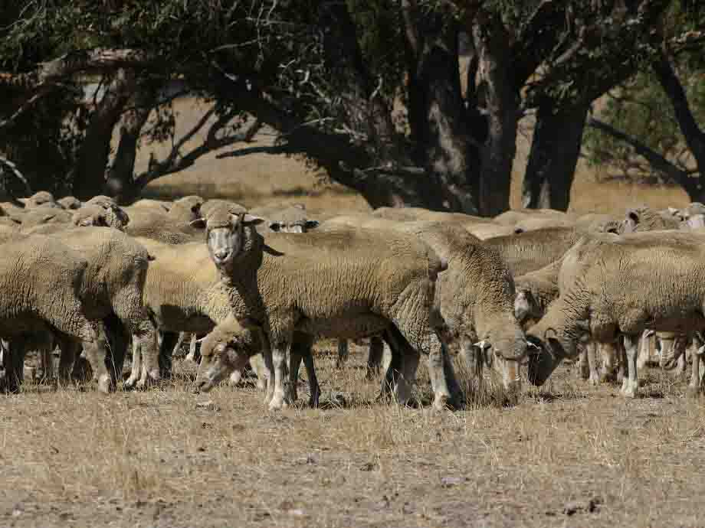
F2 Commercial ewes just before mating in 2004
*Note: Condition Score

Slide 49
2004 Matings
In 2004 we mated 4,106 F1 and F2 ewes. This included 1100 maidens
We put the Dohne Rams in on the 30th January.
We removed them on the 5th of March.
A mating of 35 days.

Slide 50
Pregnancy Scanning
2,956 ewes were carrying singles.
965 ewes were carrying twins.
185 were scanned as dry.

Slide 51
A conception rate of 119%
At Mulesing we finished with 112%.

Slide 52
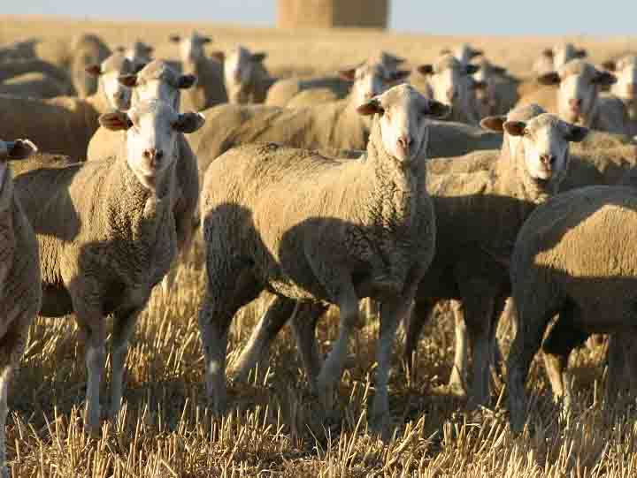
Dohne F2 Ewe Hoggets

Slide 53
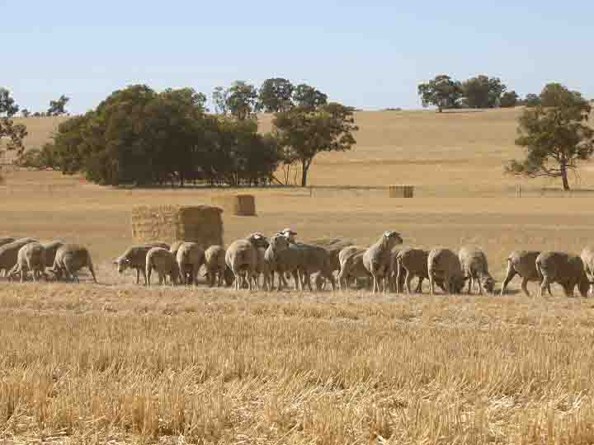

Slide 54
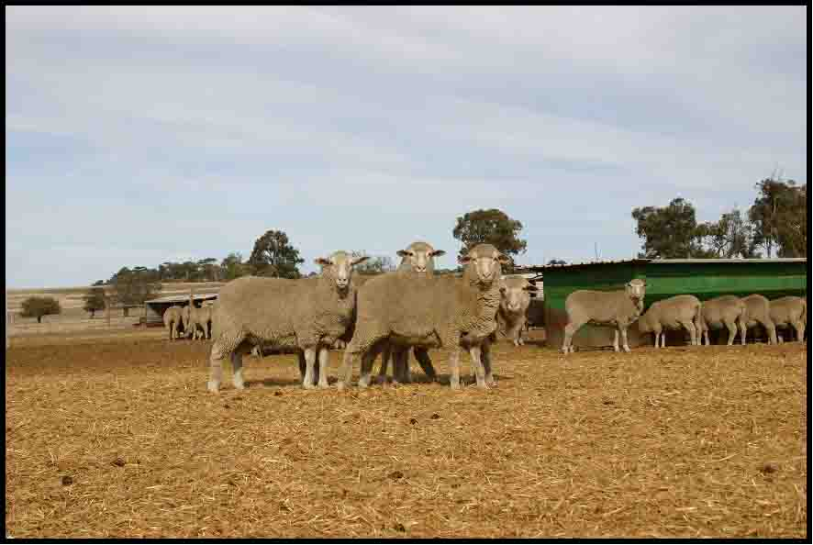
F2’s in the Feedlot

Slide 55
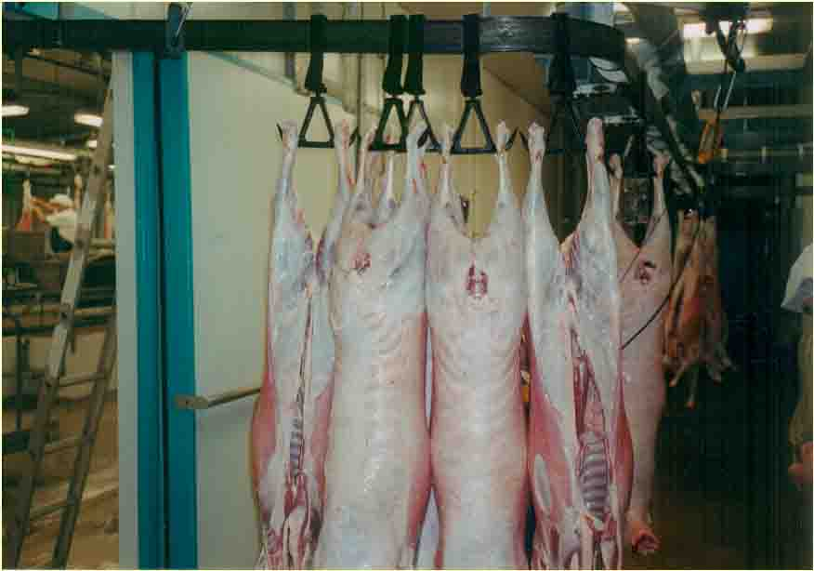
Carcasses at Hillside Meats

Slide 56
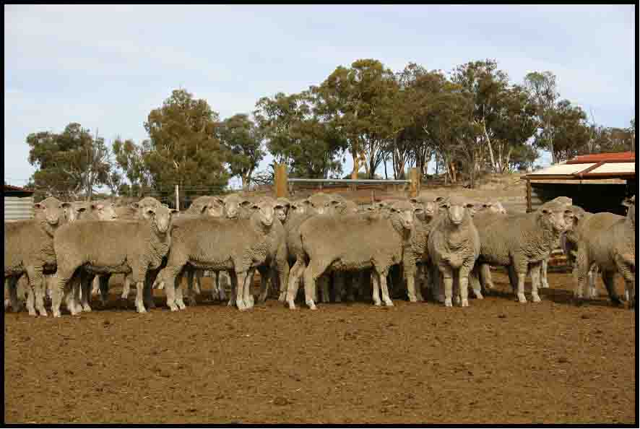
F2 wether lambs

Slide 57
2005 Matings
Total Mated 3,627 F1 & F2 Dohne Ewes.
* mating Including 1395 maidens
Joined for a 28 day period.

Slide 58
2005 Scanning
2084 were carrying Singles
1,277 were carrying multiples
266 were dry
* A Conception rate of 129%

Slide 59
2005 Lambing Results
At Mulesing we finished with 115% lambs from ewes mated.
Slightly disappointing, but there were issues with eagles, and a bad weather event during lambing.

Slide 60
2006 Matings
Total Mated 3,861 F1 & F2 Dohne Ewes.
Mating Included 1600 maidens
Joined for a 30 day period.

Slide 61
2006 Scanning
1880 were carrying Singles
1,876 were carrying multiples
105 were dry
* A Conception rate of 146%

Slide 62
2006 Lambing Results
At Mulesing we finished with 120% lambs from ewes mated.
Fantastic result given the season. This season is the worst ever recorded in my area.

Slide 63
Sheep and Cropping at Far Valley.
Currently we are 50% sheep and 50% cropping.
As we get to Purebred Dohne status in our commercials, intend to go 60% sheep and 40% cropping.

Slide 64
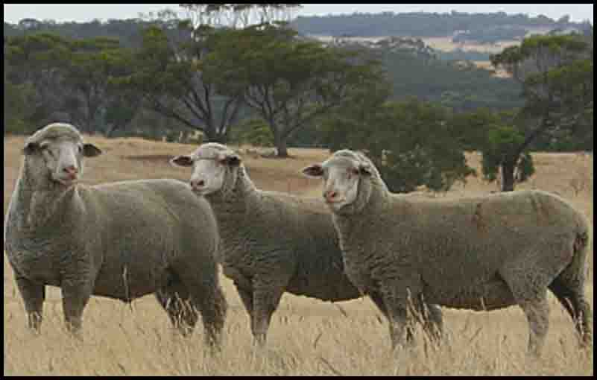
FV04 0911 with Ewe Lambs

Slide 65
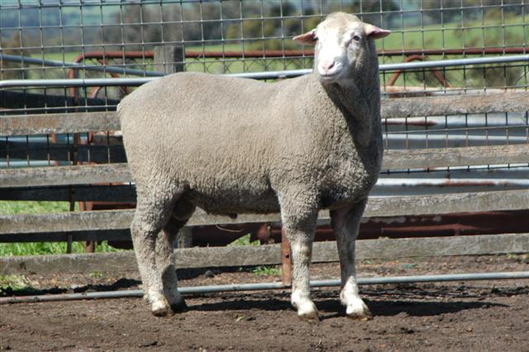

Slide 66
The growth of Stud Dohnes in Australia since 1998

Slide 67
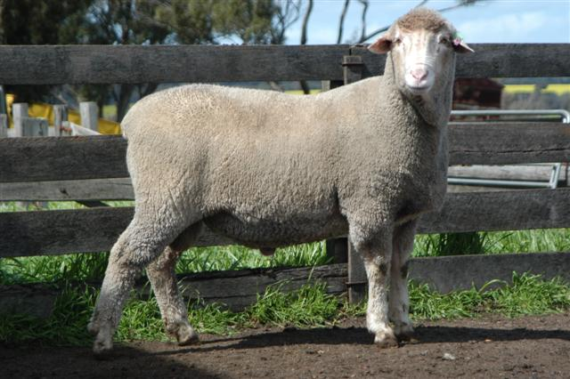

Slide 68
The End

Slide 69
Index Improvement

Slide 70
Dollars in Pockets
To put it simply, our sheep are earning us more money and importantly, more of it is staying in our pockets.

Slide 71
2005 Meat Results
At Far Valley we have sold over a 1,000 F1 & F2 wether lambs to Hillside Meats from Feb to April 2005.
Been in Q Lambs top 10% producers of the month for all 3 months.
At an average dressed weight of 22.2 kgs.
Average price of $72.00

Slide 72
Results from F2 Maiden ewes
Have been run at 16.2 WG DSE’s on 29ha.
118% Lambs (269 ewes and 317 lambs)
Lambs weighing 36.1kgs. At 80 days of age. (Birth weight 2 kgs average)
A growth rate of 451 grms/day

Slide 73
Gross Margin Projection
269 Ewes cut 5.75kg @ $5 = $7,734.00
317 Lms cut 1.5 kg @ $3 = $1,426.00
Sell 317 lambs @ $70 = $ 22,190.00
Total Gross Income = $ 31,350.00
Divided by 29 ha = $1,081.00 /ha

Slide 74
2005 Ram Lamb Contract Results
Kept all twin Ram lambs entire.
Total of 1158 Ram lambs
1100 went in the first draft off grass.= 95%
54 were sold in Midland. = 4.7%
4 NCV’s. = 0.3%
Note: The lamb’s av. age only 16 weeks.

Slide 75
2005 WAMMCO Results
In April Far Valley participated in a WAMMCO trial and our lambs performed exceptionally well, with the Far Valley lambs dressing out at 26.1 kgs and having amongst other things the largest EMA. The meat colour of the Dohne lambs were exceptional and the shape of the F2’s carcasses led WAMMCO officials to accept Dohne F2 lambs at prime lamb scheduled prices.

Slide 76
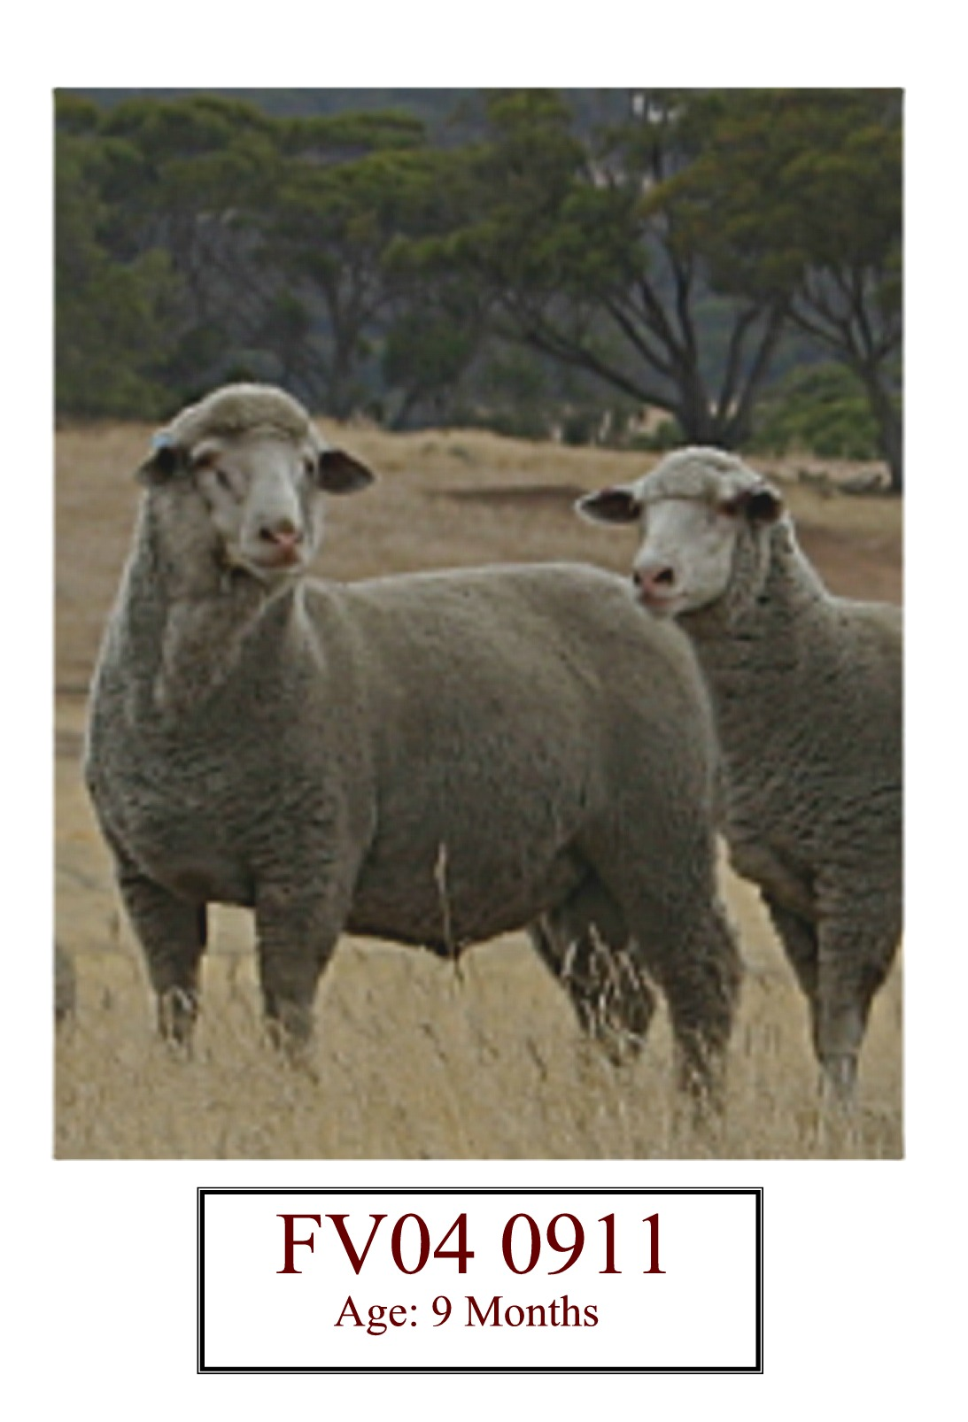
FV04 0911
Age: 9 Months

Slide 77
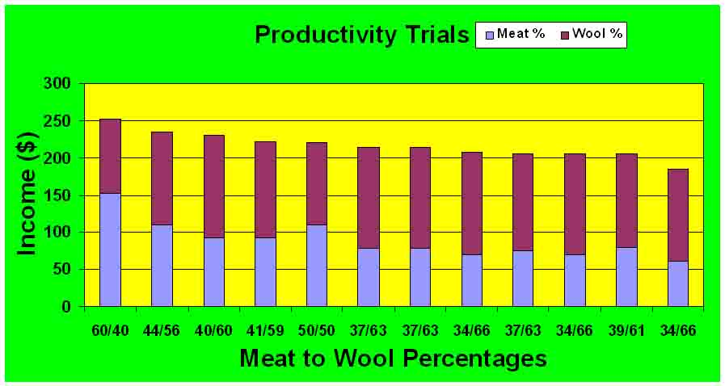
Data from Ag. WA Productivity Trials - 2004

Slide 78
12 – point mating program for autumn/early winter lambing
        Get Rams ready 6 weeks prior
        Make sure ewes are isolated from rams.
        Inject wethers twice 7 days apart, put with ewes = day 0.
        Days 7 to 14 -feed 500 grams lupins/head daily.
        Day 15 – 45 put up to 3% Rams in.

Slide 79
        Day 45 - Remove Rams and Teasers from ewes.
        Day 85 - scan ewes ( Approx. 40 days pregnant).
        Identify 0, 1 + multiples.
        Re mate your dry ewes?
        Special management for all multiples.
        Day 135 - Vaccinate ,Drench, give Vit E + Sel ?
        Implement strategies to lift lamb survival, especially twins.

Slide 80
Pregnancy Facts
        In the first month after conception, eye muscle depth is set.
        In the last month of pregnancy wool follicles are set.

Slide 81
2006 Foundation Flock Results
A single mob 1,346 F1 Foundation ewes
561 Singles
726 multiples
59 dry
Conception rate of 149%

Slide 82
Flock Description in 1998
We had a 20 micron flock.
Producing 36 kg.s of wool per hectare.
We were running 8.9 d.s.e.’s to the Hectare.
Achieving 75% lambing.

